Slide 1
Progressive Web Apps
Pandiyan Murugan

Slide 2


Slide 3
Apps
Native Apps
Web Apps
Notes:
Difference b/w Native Apps and Web Apps

Slide 4
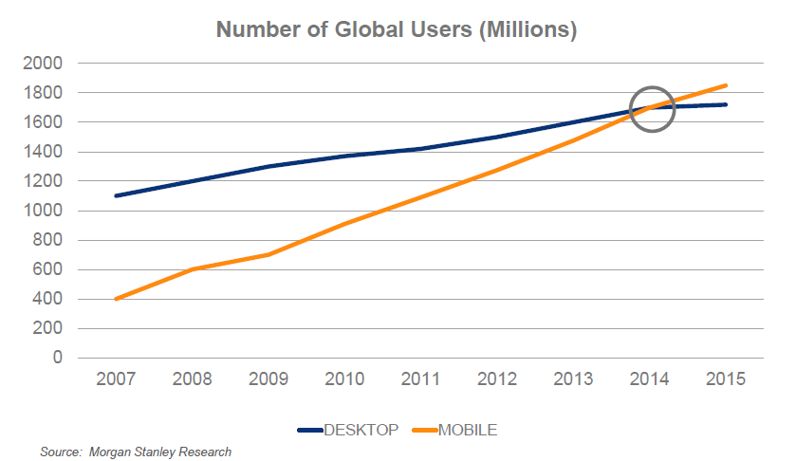
Global Users
Notes:
Mobile users are growing

Slide 5
Progressive Web Apps are
Fast
Integrated
Reliable
Engaging
Notes:
FIRE properties

Slide 6
Fast
Respond quickly to user interactions with silky smooth animations and no janky scrolling.
So how fast a web app should load a page?
~ < 3 seconds
53% of users will abandon a site if it takes longer than 3 seconds to load! And once loaded, users expect them to be fast—no janky scrolling or slow-to-respond interfaces.
Now, tell me how fast the websites we are developing/developed is loading?
Notes:
Next slide is graph

Slide 7
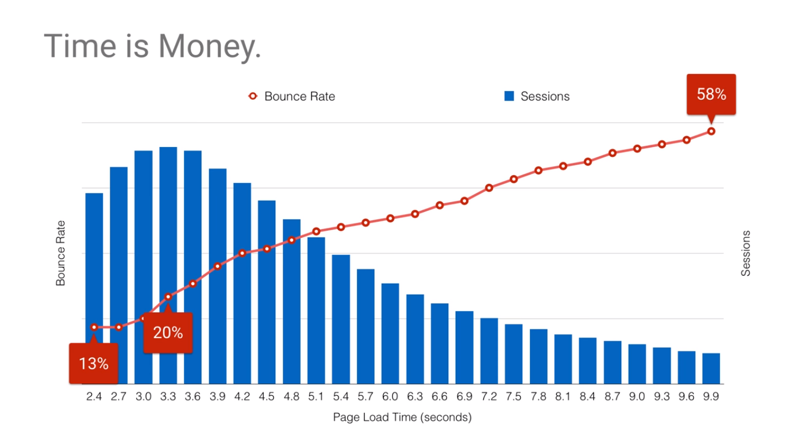
Notes:
Bounce rate is 20% if your website takes more than 3.3 seconds to load

Slide 8
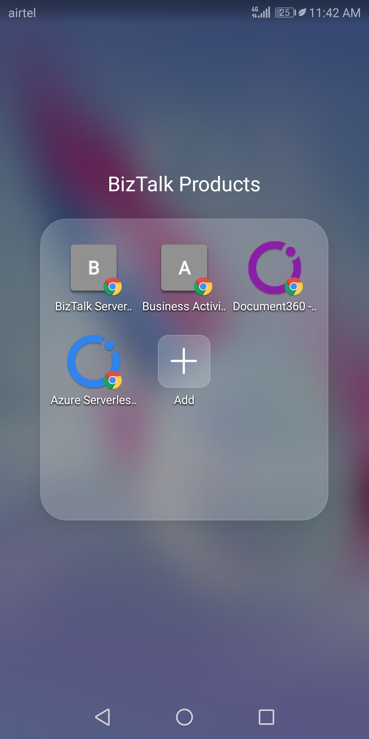
Integrated Experiences
Notes:
New form of bookmark, lets say

Slide 9

Notes:
BizTalk360 website

Slide 10
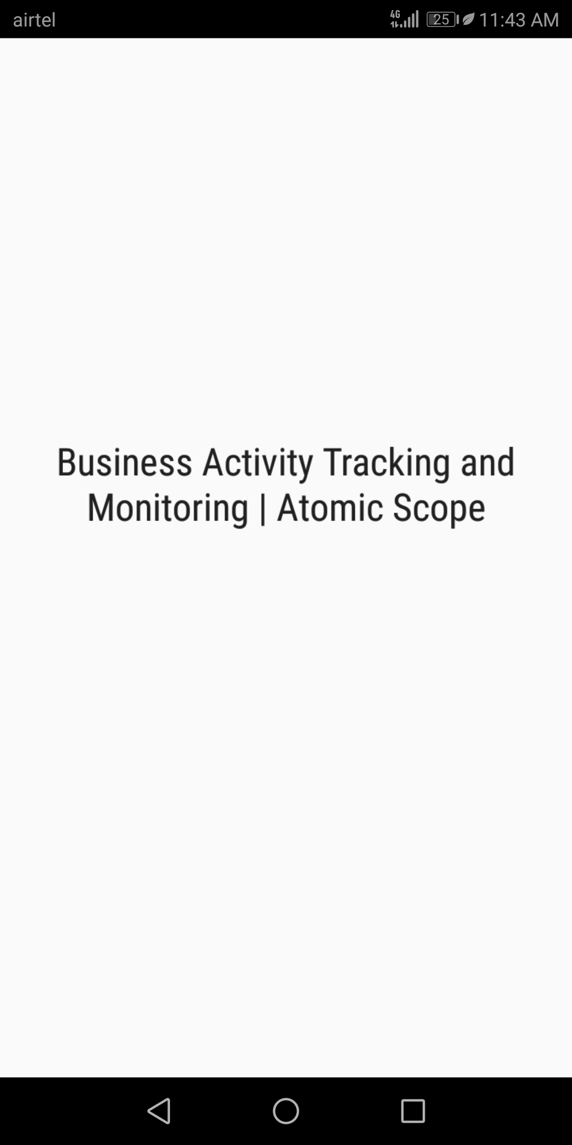
Notes:
Atomic Scope temporary screen

Slide 11
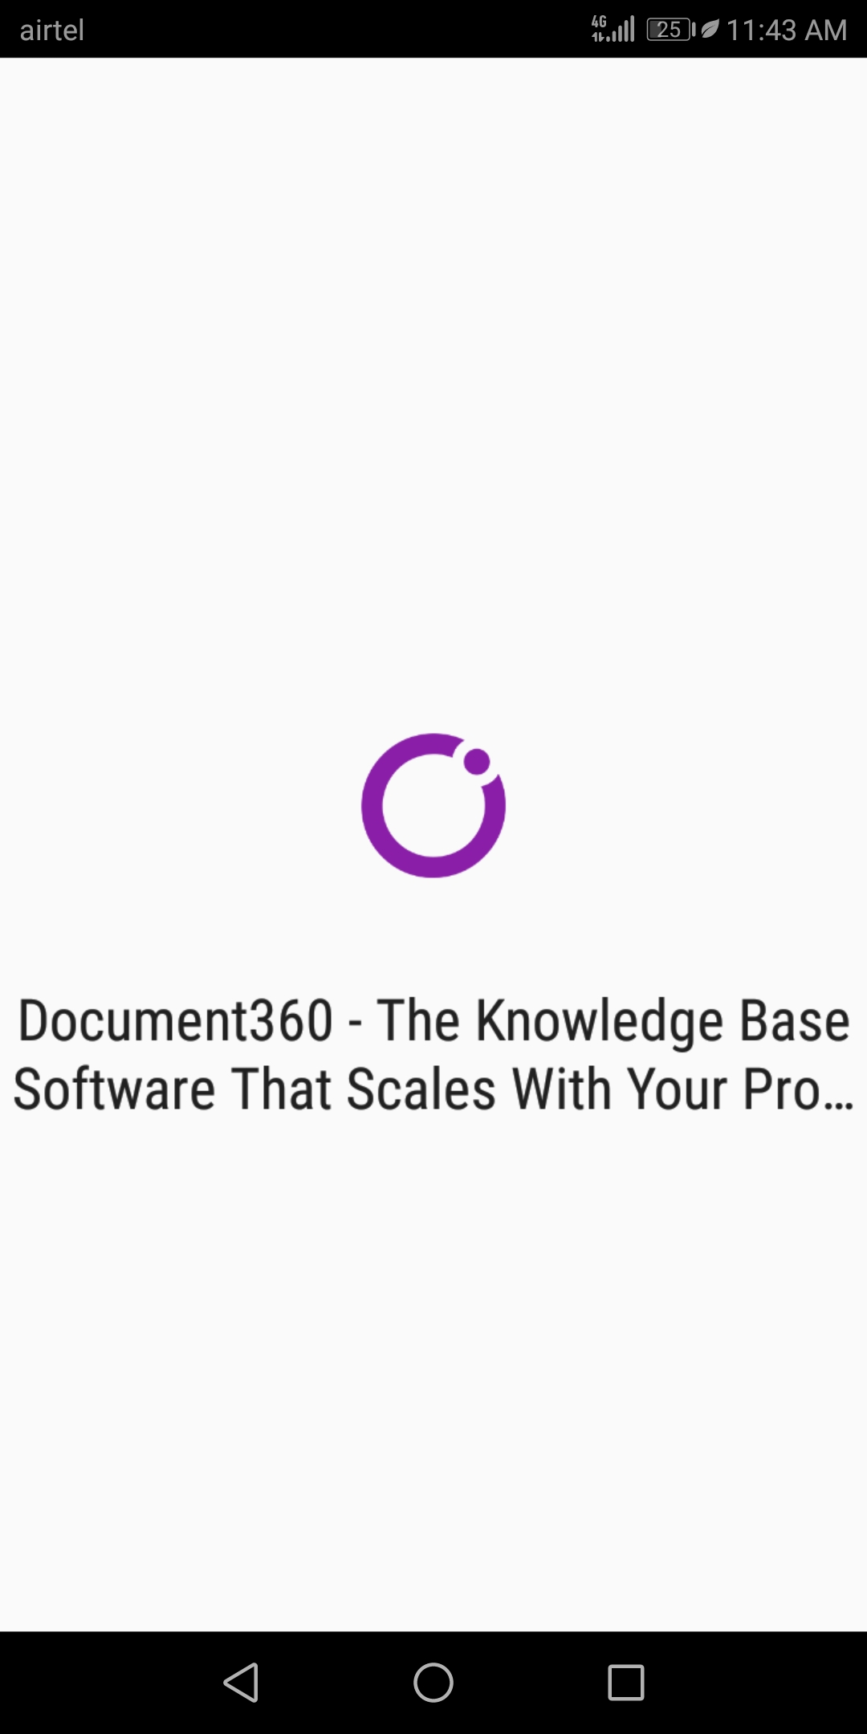
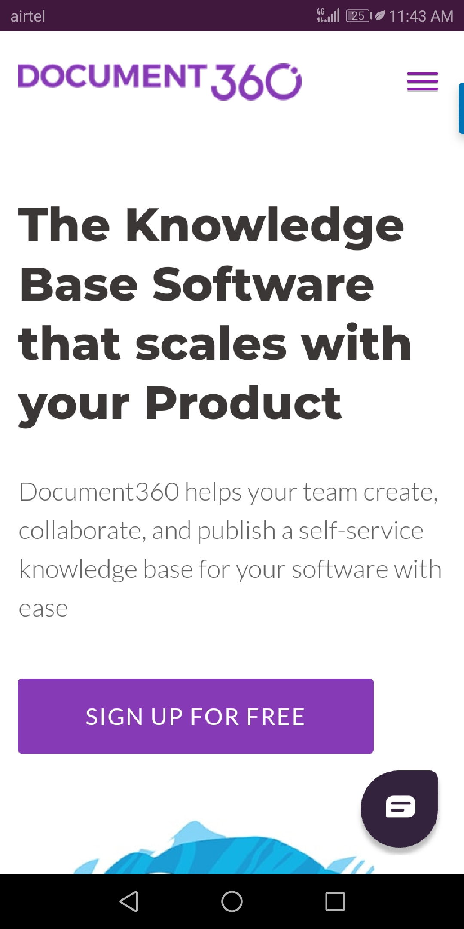
Notes:
Document 360 logo and message

Slide 12
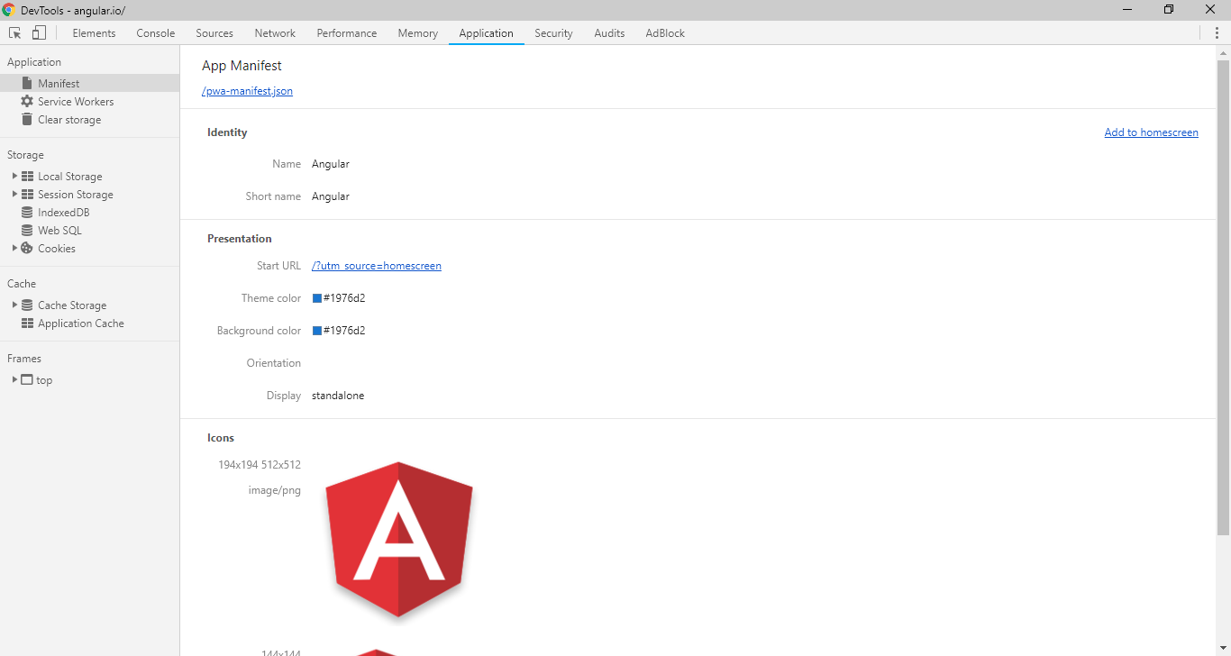
Angular home page

Slide 13
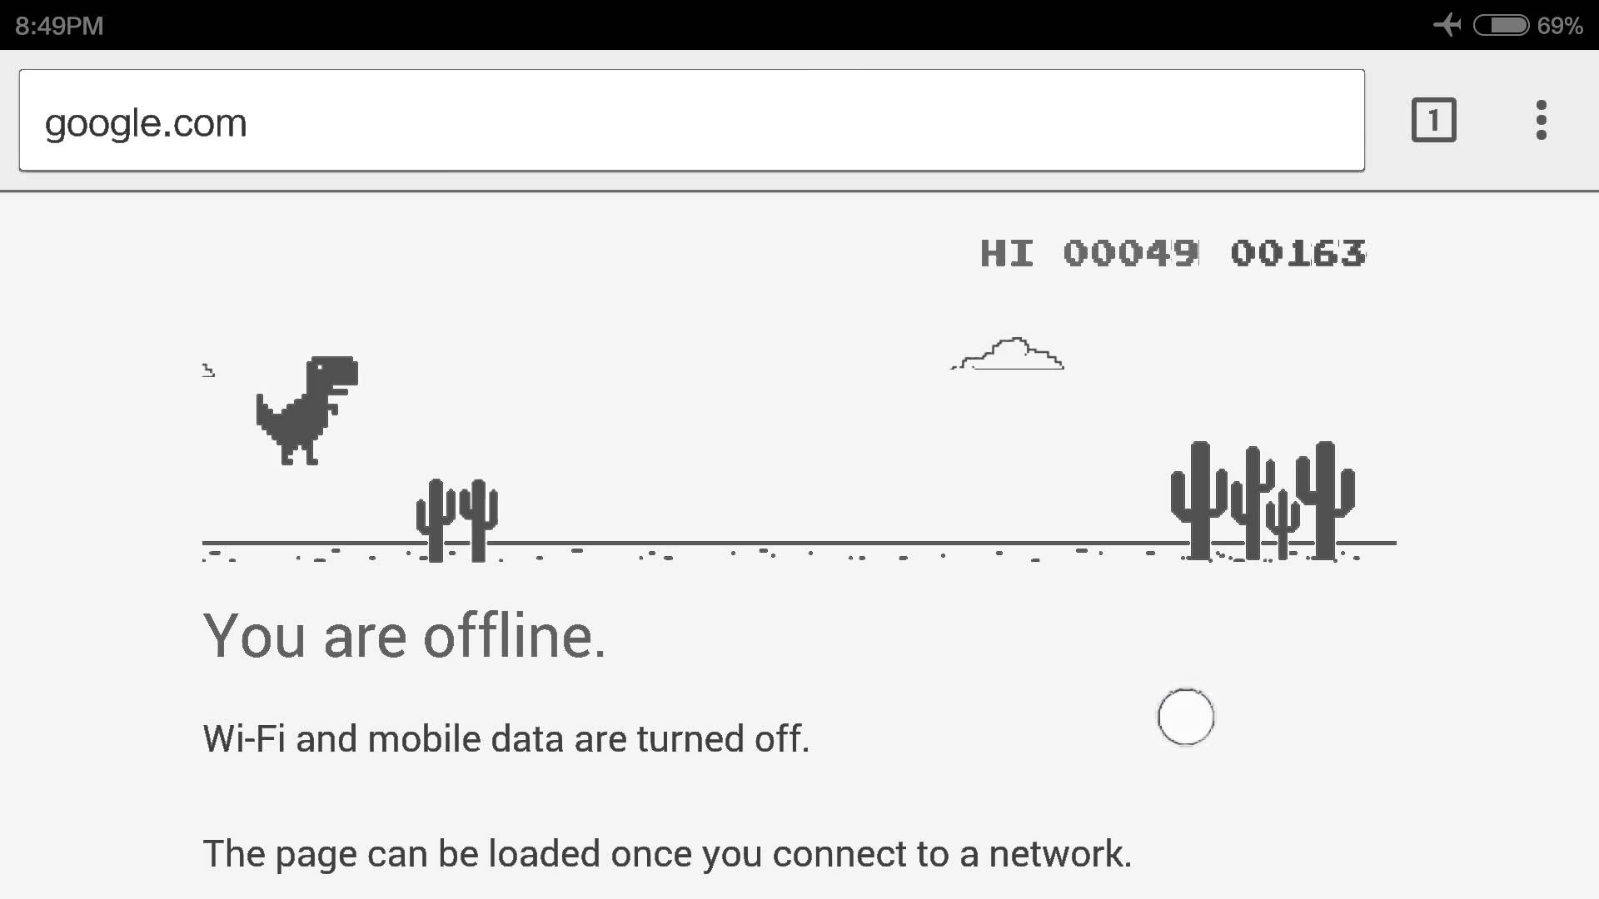
Reliable
Load instantly and never show the downasaur, even in uncertain network conditions.
When launched from the user’s home screen, service workers enable a Progressive Web App to load instantly, regardless of the network state.

Slide 14
Connection mode
Perfect
Slow
Lie-fi
offline
Notes:
Show demo after GIF slides

Slide 15

Perfect

Slide 16

Slow

Slide 17

Lie Fi

Slide 18

Offline

Slide 19
Engaging
Feel like a natural app on the device, with an immersive user experience.
Progressive Web Apps are installable and live on the user's home screen, without the need for an app store.
They offer an immersive full screen experience with help from a web app manifest file and can even re-engage users with web push notifications.

Slide 20
Why build a Progressive Web App?
Building a high-quality Progressive Web App has
incredible benefits
making it easy to delight your users
grow engagement
increase conversions

Slide 21
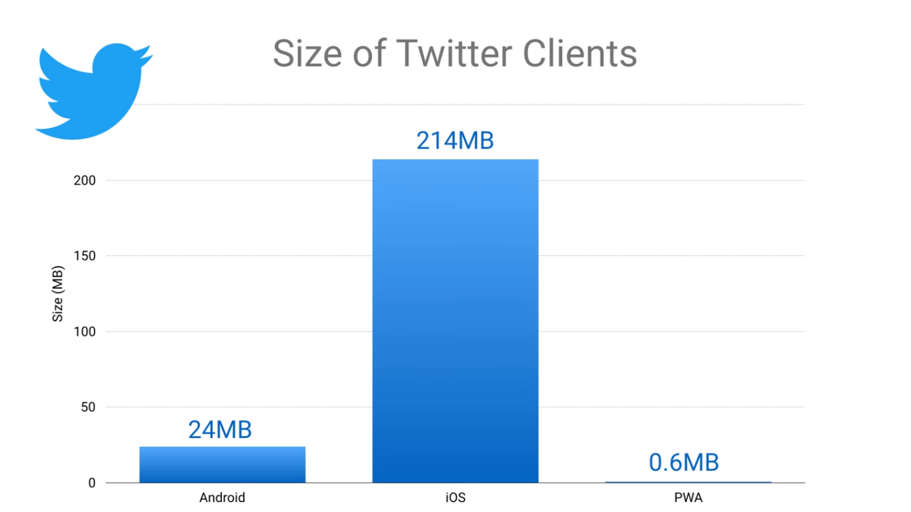
Example

Slide 22
Three Approaches to PWA-ifying
from the ground up
a simple version
a single feature

Slide 23
What’s next?
Offline first
Service workers
Indexed db and caching
Web App Manifest
Push notifications

Slide 24
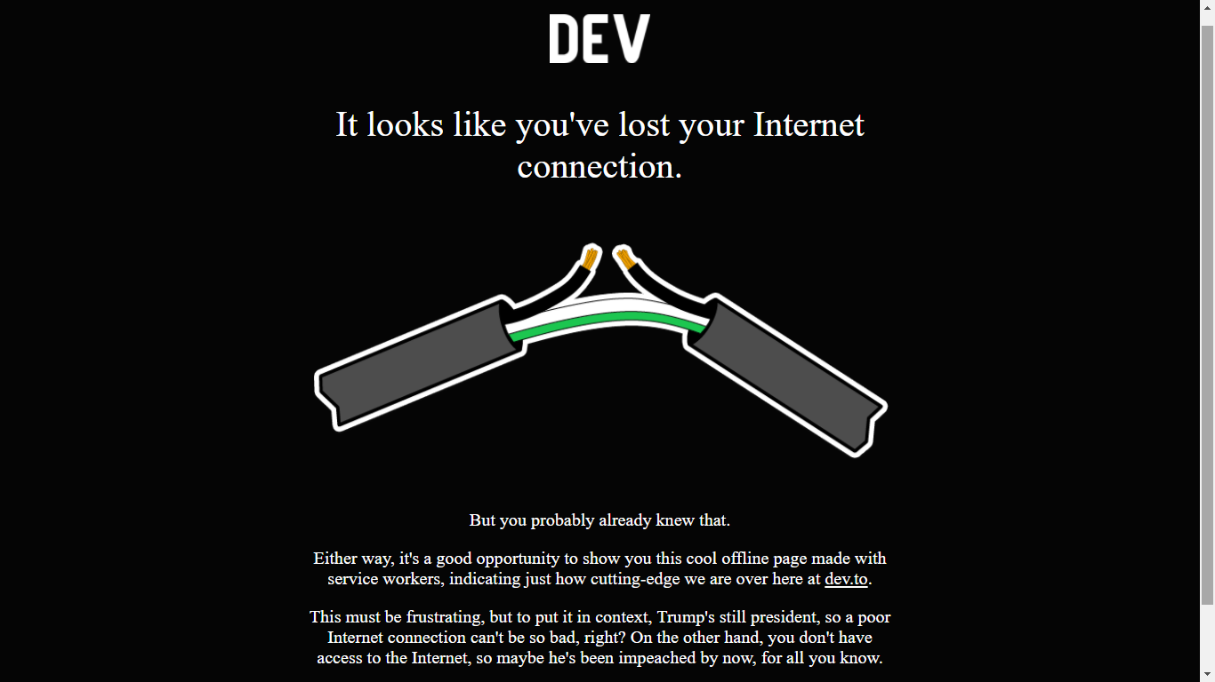
Offline first
Notes:
Dev.to website shows this informative error page

Slide 25

Make a request
Notes:
Usual HTTP request

Slide 26

Service worker

Slide 27
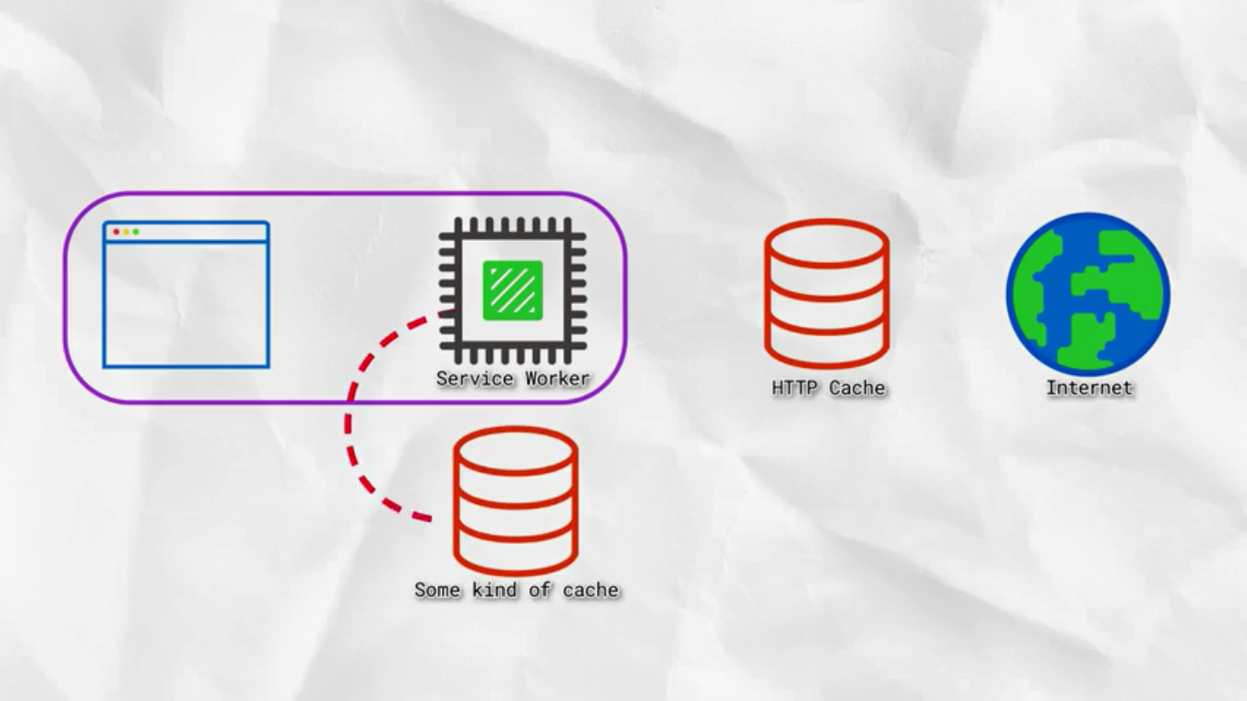
Service worker

Slide 28
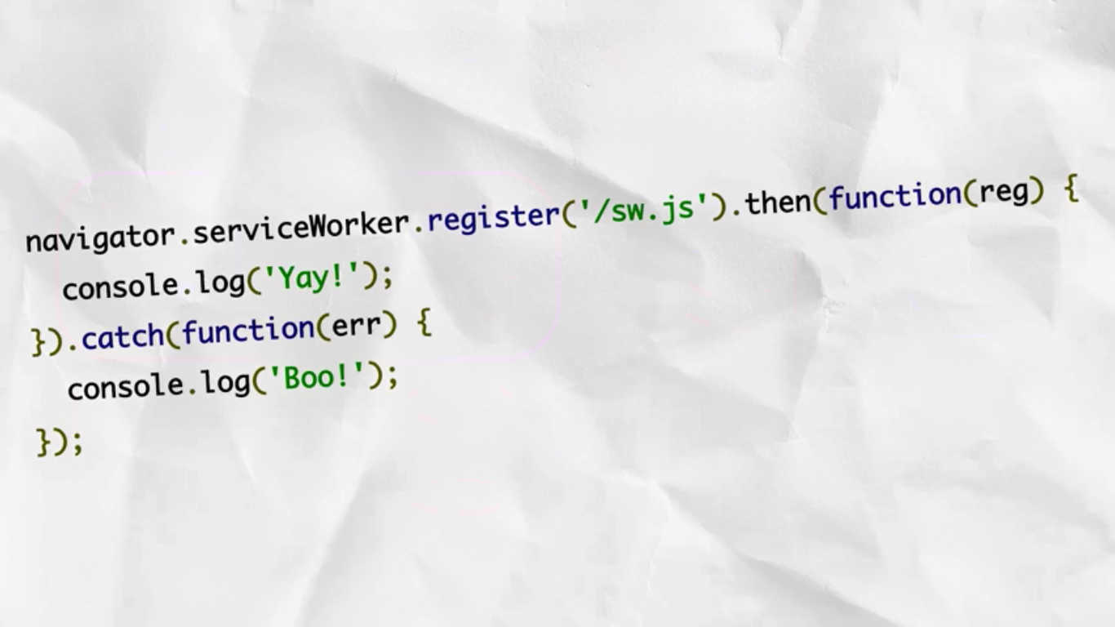
How it works?

Slide 29
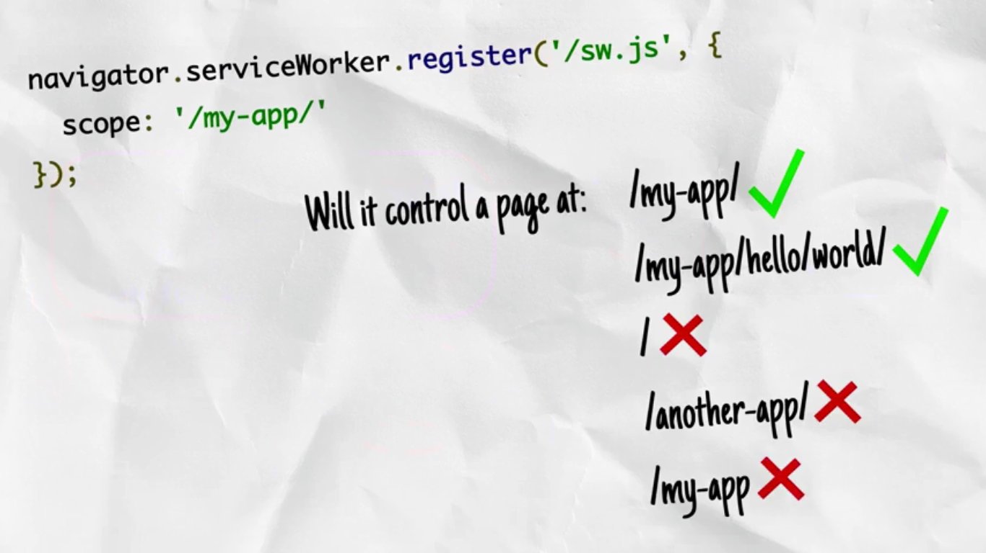
Scope of service worker

Slide 30
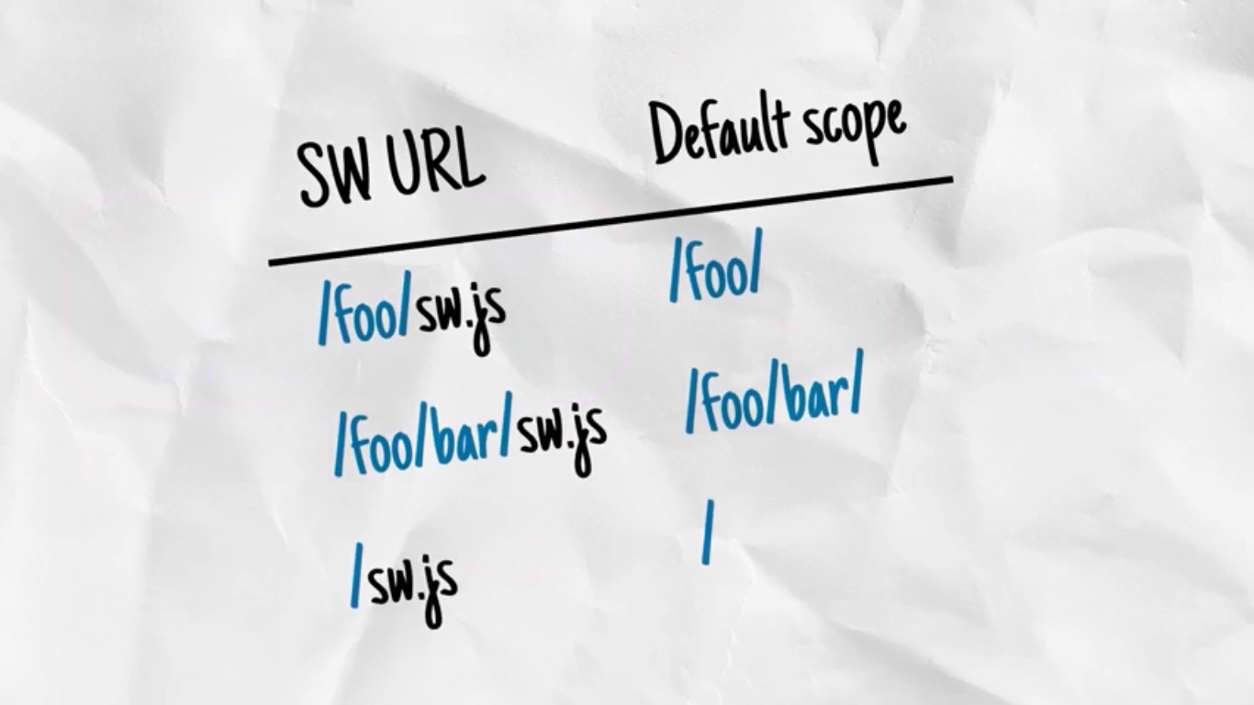
Placing the service worker

Slide 31
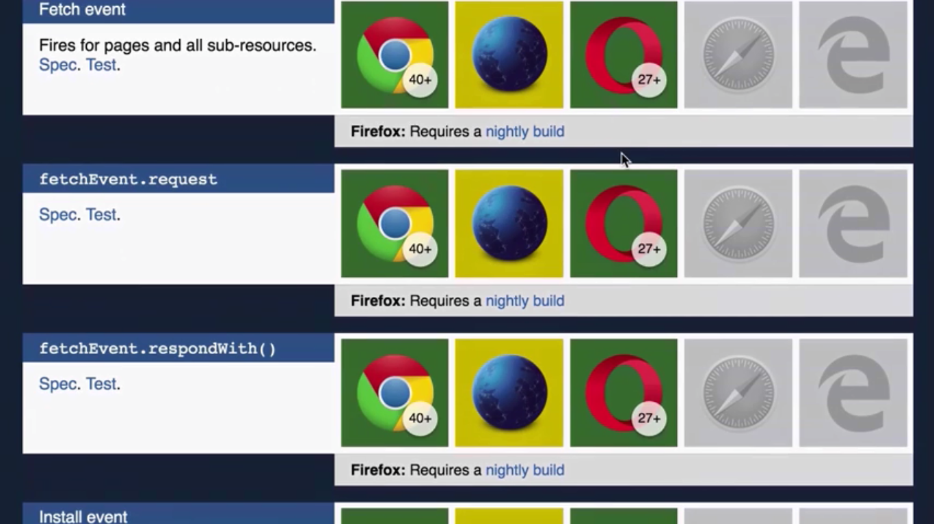
Browser support

Slide 32

Is Internet Explorer counts?

Slide 33
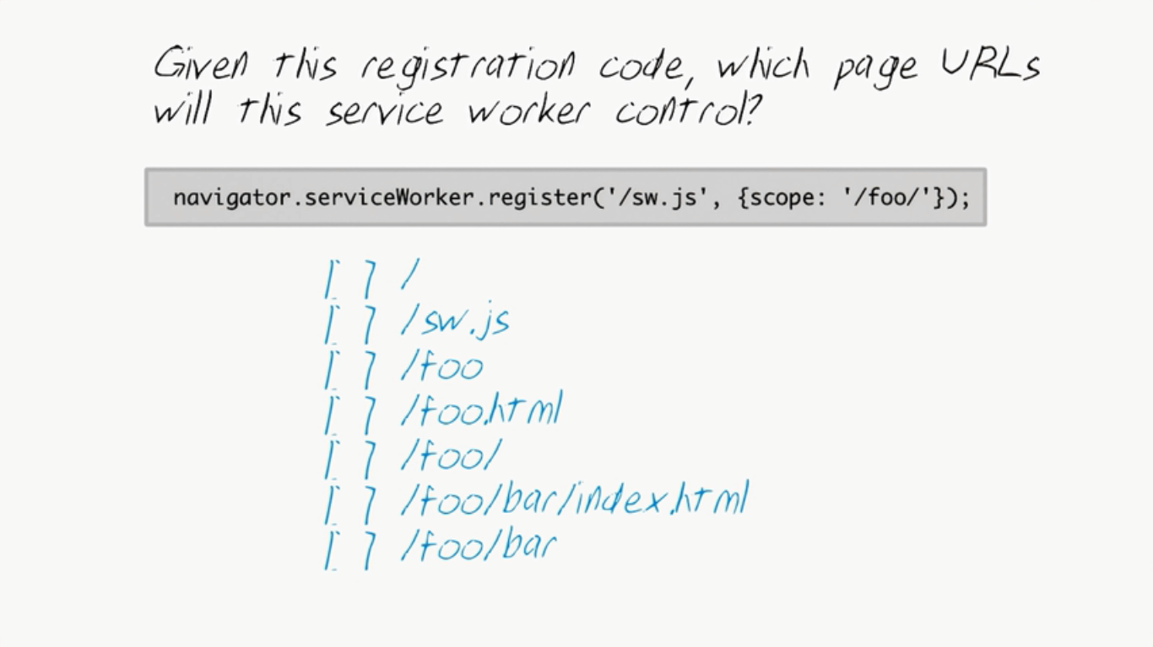
Quiz?

Slide 34
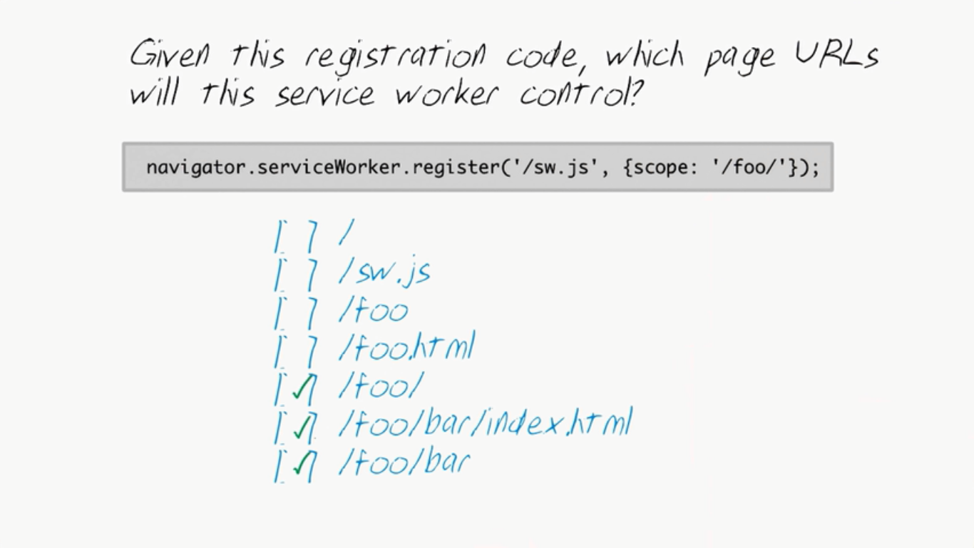
Answer

Slide 35
Lets see examples
Notes:
Show service workers custom URL loading

Slide 36

That’s it! Interesting?

Slide 37

References
https://www.youtube.com/watch?v=z2JgN6Ae-Bo&t=9s
https://classroom.udacity.com/courses/ud899-in

